Slide 1

CU-EduLink
L Vinay Kumar Reddy
(Dept. of Computer Science.)
Christ University
Thangavignesh T
(Dept. of Computer Science.)
Christ University
MISSION
CHRIST is a nurturing ground for an individual’s holistic development to make effective contribution to the society in a dynamic environment
VISION
Excellence and Service
CORE VALUES
Faith in God | Moral Uprightness Love of Fellow Beings
Social Responsibility | Pursuit of Excellence

Slide 2
CHRIST
Deemed to be University
AGENDA
Introduction
Existing work
Project alignment with SDG goals
Project outcome and Planning
Contribution
Ui design
Excellence and Service

Slide 3
CHRIST
Deemed to be University
Introduction
The absence of a robust note-sharing infrastructure restricts the flow of educational resources among students, impeding the collective growth of the academic community. Recognizing these deficiencies is crucial in our pursuit to enhance the learning experience and ensure that students and educators have access to innovative tools that align with the demands of the modern educational ecosystem. EduLink emerges as a strategic response to these challenges, ushering in a new era of collaborative and technology-driven education.
Excellence and Service

Slide 4
CHRIST
Deemed to be University
Introduction
The Need for a Collaborative Learning Platform:
Breaking Classroom Barriers
Enhancing Teacher-Student Engagement
Facilitating Knowledge Sharing
Adapting to Diverse Learning Styles
Preparing for the Digital Age
Meeting the Challenges of Remote Learning
Supporting Educators in Modern Pedagogy
Excellence and Service

Slide 5
CHRIST
Deemed to be University
Introduction
Introducing EduLink as the Solution:
In response to the evolving needs of the education landscape, EduLink emerges as a transformative solution designed to revolutionize the way we approach learning and collaboration.
Empowering Collaboration
Seamless Knowledge Sharing
Interactive Learning Opportunities
Adaptive to Diverse Learning Styles
Future-Ready Education
Excellence and Service

Slide 6
CHRIST
Deemed to be University
Existing work
Limitations of Traditional Learning Management Systems: Traditional learning management systems often struggle to keep pace with the evolving needs of the education landscape. Their rigid structures and limited flexibility can hinder dynamic collaboration and interactive learning experiences, leading to a disconnect between educators and students.
Excellence and Service

Slide 7
CHRIST
Deemed to be University
Existing work
Addressing Gaps in Collaboration, Note-Sharing, and Student Engagement:
Existing learning management systems may fall short in fostering meaningful collaboration, efficient note-sharing, and active student engagement. These gaps create barriers to a holistic learning environment, inhibiting the seamless flow of information and interaction critical for effective education.
Excellence and Service

Slide 8
CHRIST
Deemed to be University
Existing work
Emphasizing the Need for Innovation in Educational Technology:
The current educational climate demands a paradigm shift towards innovative solutions. As traditional systems struggle to adapt, there is a pressing need for educational technology that goes beyond conventional boundaries, addressing collaboration challenges, encouraging note-sharing, and enhancing overall student engagement. EduLink emerges as a response to this critical need, bringing innovation to the forefront of the education experience.
Excellence and Service

Slide 9
CHRIST
Deemed to be University
SDG goals
Related to Education (e.g., SDG 4 - Quality Education): Quality Education, as outlined in Sustainable Development Goal 4 (SDG 4), stands as a cornerstone for societal progress. It envisions an inclusive and equitable education for all, fostering lifelong learning opportunities. EduLink aligns seamlessly with this global objective by redefining educational access, promoting collaboration, and offering a platform where every learner can thrive, regardless of geographical constraints or traditional learning barriers.
Excellence and Service

Slide 10
CHRIST
Deemed to be University
SDG goals
How EduLink Contributes to Achieving the Selected SDG: EduLink serves as a catalyst in realizing the aspirations of SDG 4 by leveraging technology to bridge educational gaps. Through its collaborative learning features, EduLink democratizes access to quality education, providing a virtual space where teachers and students connect, share knowledge, and engage in interactive learning experiences. By facilitating inclusive education, EduLink actively contributes to the overarching goal of ensuring quality learning opportunities for all.
Excellence and Service

Slide 11
CHRIST
Deemed to be University
SDG goals
Importance of Technology in Advancing Global Education Goals:
EduLink underscores the transformative power of technology in breaking down traditional barriers, expanding educational access, and fostering a global community of learners. By embracing innovative tech-driven solutions, EduLink not only enhances the educational experience but also paves the way for a future where technology is instrumental in achieving equitable, inclusive, and quality education on a global scale.
Excellence and Service

Slide 12
CHRIST
Deemed to be University
Project outcome and Planning
Project Planning:
EduLink's development journey has been marked by strategic planning and key milestones. The project began with a comprehensive analysis of educational challenges and user requirements, shaping the platform's features. Key milestones include the successful implementation of user registration, note uploading functionalities, and the seamless integration of interactive learning tools. Looking forward, the project roadmap envisions continuous refinement, incorporating user feedback, and expanding features to ensure EduLink remains at the forefront of cutting-edge educational technology.
Excellence and Service

Slide 13
CHRIST
Deemed to be University
Project outcome and Planning
Project Outcome:
The implementation of EduLink is poised to yield transformative outcomes in the educational landscape. By fostering collaborative learning, the platform will significantly enhance student engagement and knowledge sharing. The dynamic nature of EduLink ensures that students actively participate in discussions, share notes seamlessly, and cultivate a culture of collaborative learning. Moreover, the long-term benefits extend to educational institutions, where EduLink becomes a cornerstone in building a digitally advanced, interactive, and future-ready learning environment.
Excellence and Service

Slide 14
CHRIST
Deemed to be University
Contribution
Team:
Discussing the requirements, designing the pages, creating reports, implementing the modules, Use-case, Data-flow diagram.
Individual:
Thangavignesh T : Login Page design, User Profile Design, Notes page design.
Vinay Kumar Reddy: Landing Page Design, PPT creation, , report creation
Excellence and Service

Slide 15
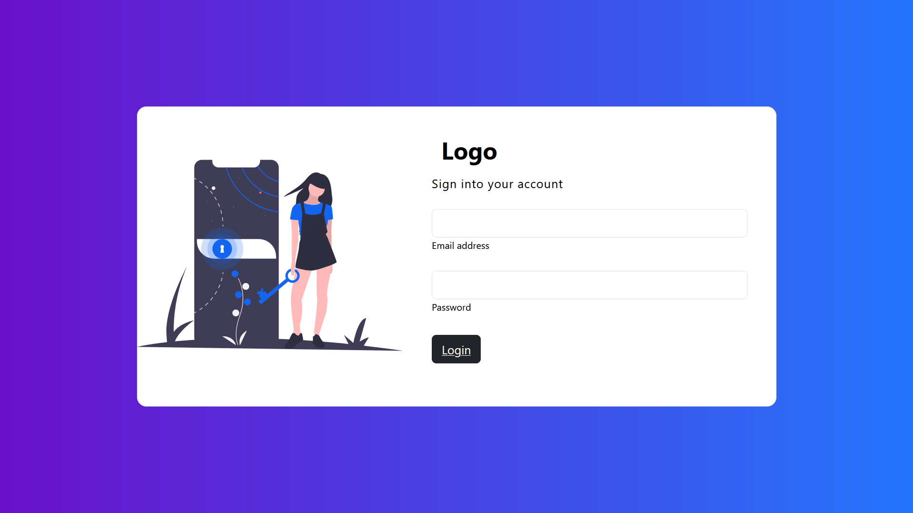
CHRIST
Deemed to be University
UI design
Login Page:
Excellence and Service

Slide 16
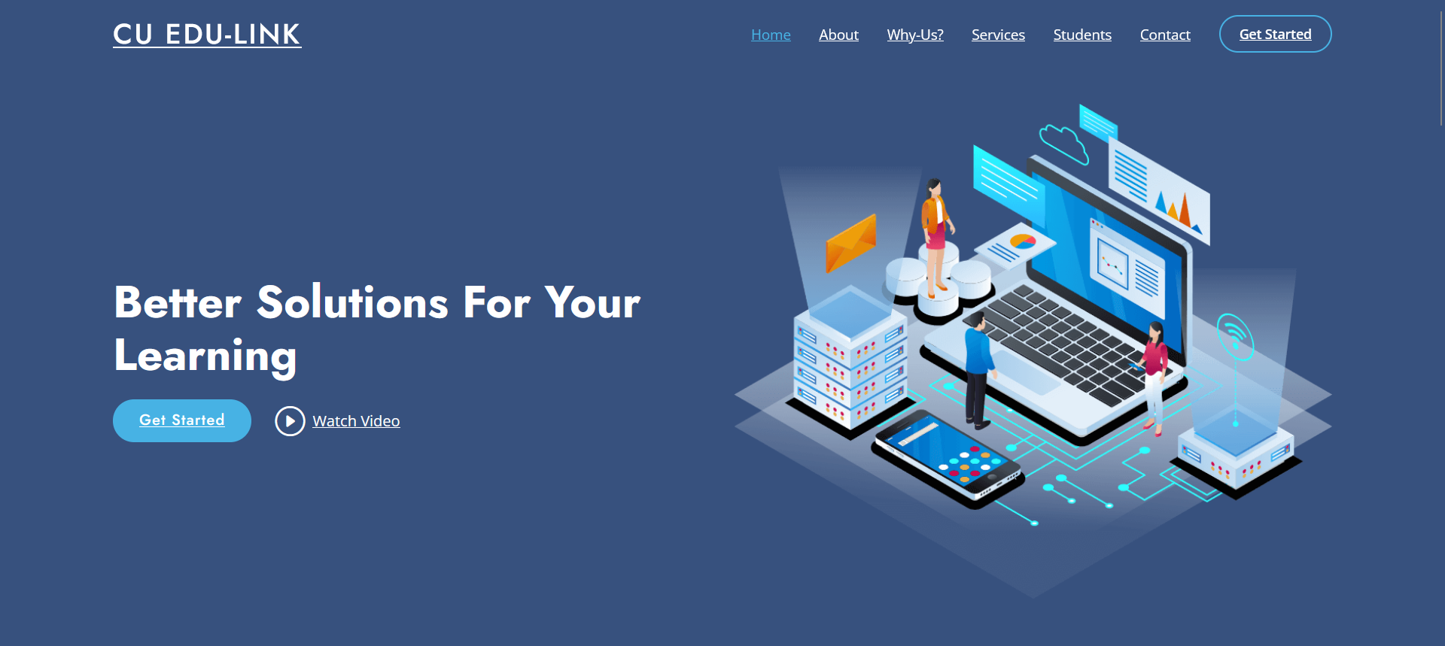
CHRIST
Deemed to be University
UI design
Landing Page:
Excellence and Service

Slide 17
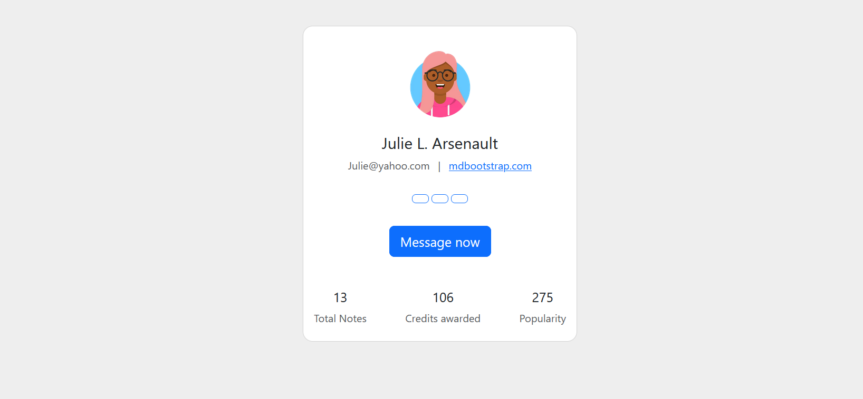
CHRIST
Deemed to be University
UI design
User profile page:
Excellence and Service

Slide 18
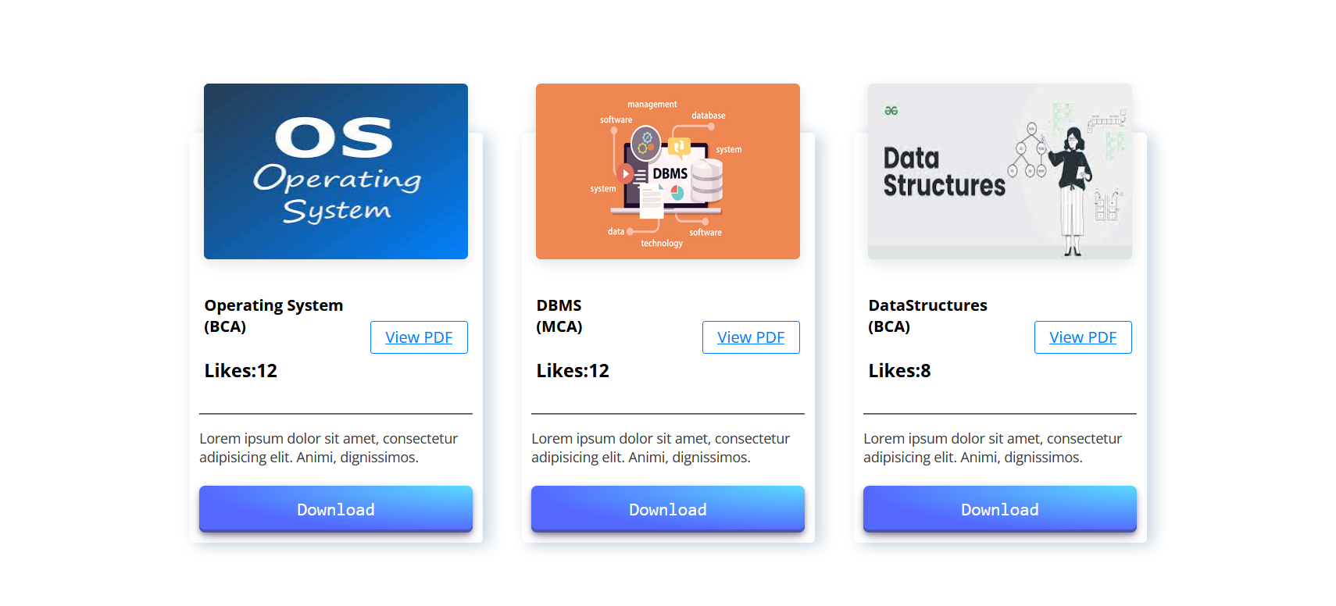
CHRIST
Deemed to be University
UI design
Notes Page:
Excellence and Service

Slide 19
CHRIST
Deemed to be University
Thank You
Excellence and Service

